Slide 1
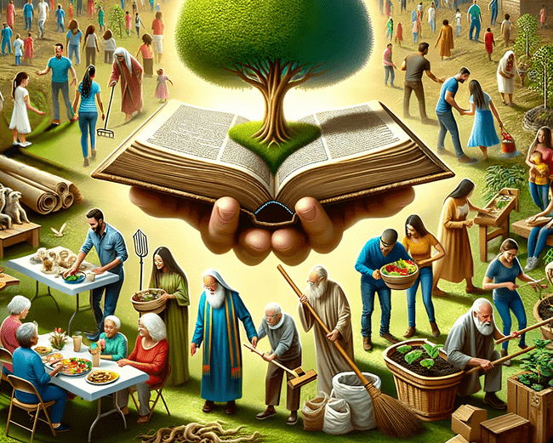
Did You Ask,
“What Should I Do?”
Luke 3:2-14
Notes:
Stuart Fain ~ February 18, 2024 (AM)

Slide 2
Luke 3:2-14 (NKJV)
² while Annas and Caiaphas were high priests, the word of God came to John the son of Zacharias in the wilderness. ³ And he went into all the region around the Jordan, preaching a baptism of repentance for the remission of sins,

Slide 3
Luke 3:2-14 (NKJV)
⁴ as it is written in the book of the words of Isaiah the prophet, saying: "The voice of one crying in the wilderness: "Prepare the way of the LORD; Make His paths straight. ⁵ Every valley shall be filled and every mountain and hill brought low;

Slide 4
Luke 3:2-14 (NKJV)
The crooked places shall be made straight And the rough ways smooth; ⁶ And all flesh shall see the salvation of God.' " ⁷ Then he said to the multitudes that came out to be baptized by him,

Slide 5
Luke 3:2-14 (NKJV)
"Brood of vipers! Who warned you to flee from the wrath to come? ⁸ Therefore bear fruits worthy of repentance, and do not begin to say to yourselves, "We have Abraham as our father.'

Slide 6
Luke 3:2-14 (NKJV)
For I say to you that God is able to raise up children to Abraham from these stones.⁹ And even now the ax is laid to the root of the trees. Therefore every tree which does not bear good fruit is cut down and thrown into the fire."

Slide 7
Luke 3:2-14 (NKJV)
¹⁰ So the people asked him, saying, "What shall we do then?" ¹¹ He answered and said to them, "He who has two tunics, let him give to him who has none; and he who has food, let him do likewise."

Slide 8
Luke 3:2-14 (NKJV)
¹² Then tax collectors also came to be baptized, and said to him, "Teacher, what shall we do?" ¹³ And he said to them, "Collect no more than what is appointed for you."

Slide 9
Luke 3:2-14 (NKJV)
¹⁴ Likewise the soldiers asked him, saying, "And what shall we do?" So he said to them, "Do not intimidate anyone or accuse falsely, and be content with your wages."

Slide 10
What Shall I Ask?:
Why Work?
What Work?
Work How?

Slide 11
Point #1: Why Work?
Colossians 1:9-10 (NAS)
Revelation 22:12 (NKJV)
I Peter 1:17 (NKJV)

Slide 12
Colossians 1:9-10 (NAS)
⁹ For this reason we also, since the day we heard about it, have not ceased praying for you and asking that you may be filled with the knowledge of His will in all spiritual wisdom and understanding,

Slide 13
Colossians 1:9-10 (NAS)
¹⁰ so that you will walk in a manner worthy of the Lord, to please Him in all respects, bearing fruit in every good work and increasing in the knowledge of God;

Slide 14
Revelation 22:12 (NKJV)
"And behold, I am coming quickly, and My reward is with Me, to give to every one according to his work.

Slide 15
I Peter 1:17 (NKJV)
And if you call on the Father, who without partiality judges according to each one's work, conduct yourselves throughout the time of your stay here in fear;

Slide 16
Point #2: What Work?
Matthew 28:19 (KJV)
I Corinthians 14:12 (NKJV)
I John 3:17 (NKJV)

Slide 17

Evangelism
Benevolence
Edification

Slide 18
Matthew 28:19 (KJV)
Go ye therefore, and teach all nations, baptizing them in the name of the Father, and of the Son, and of the Holy Ghost:

Slide 19
I Corinthians 14:12 (NKJV)
So you too, since you are eager to possess spiritual gifts, strive to excel for the edification of the church.

Slide 20
I John 3:17 (NKJV)
But whoever has this world's goods, and sees his brother in need, and shuts up his heart from him, how does the love of God abide in him?

Slide 21
Point #3: Work How?
Titus 2:15-3:1 (NKJV)
Hebrews 13:7 (NAS)
Titus 1:4-5 (NKJV)

Slide 22
Titus 2:15-3:1 (NKJV)
¹⁵ Speak these things, exhort, and rebuke with all authority. Let no one despise you.
¹ Remind them to be subject to rulers and authorities, to obey, to be ready for every good work,

Slide 23
Hebrews 13:7 (NAS)
Remember those who led you, who spoke the word of God to you; and considering the result of their way of life, imitate their faith.

Slide 24
Titus 1:4-5 (NKJV)
⁴ To Titus, a true son in our common faith: Grace, mercy, and peace from God the Father and the Lord Jesus Christ our Savior.

Slide 25
Titus 1:4-5 (NKJV)
⁵ For this reason I left you in Crete, that you should set in order the things that are lacking, and appoint elders in every city as I commanded you

Slide 26
Ephesians 4:14-16 (NLT)
¹⁴ Then we will no longer be immature like children. We won't be tossed and blown about by every wind of new teaching. We will not be influenced when people try to trick us with lies so clever they sound like the truth.

Slide 27
Ephesians 4:14-16 (NLT)
¹⁵ Instead, we will speak the truth in love, growing in every way more and more like Christ, who is the head of his body, the church.
¹⁶ He makes the whole body fit together perfectly.

Slide 28
Ephesians 4:14-16 (NLT)
As each part does its own special work, it helps the other parts grow, so that the whole body is healthy and growing and full of love.

Slide 29

…that Christ died for our sins according to the scriptures;
And that he was buried, and that he rose again the third day according to the scriptures:

Slide 30
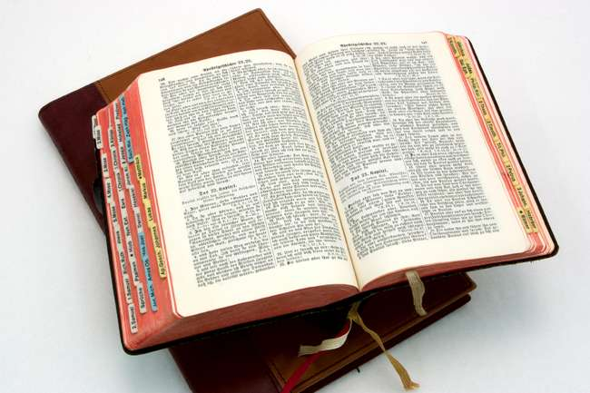
Hear: Romans 10:17
So then faith cometh by hearing, and hearing by the word of God.

Slide 31
Believe: Hebrews 11:6
But without faith it is impossible to please him: for he that cometh to God must believe that he is, and that he is a rewarder of them that diligently seek him.

Slide 32
Repent: Luke 13:3
I tell you, Nay: but, except ye repent, ye shall all likewise perish.

Slide 33
Confess: Matthew 10:32-33
32 Whosoever therefore shall confess me before men, him will I confess also before my Father which is in heaven.
33 But whosoever shall deny me before men, him will I also deny before my Father which is in heaven.

Slide 34
Baptize: Acts 22:16
And now why tarriest thou? arise, and be baptized, and wash away thy sins, calling on the name of the Lord.

