Slide 1
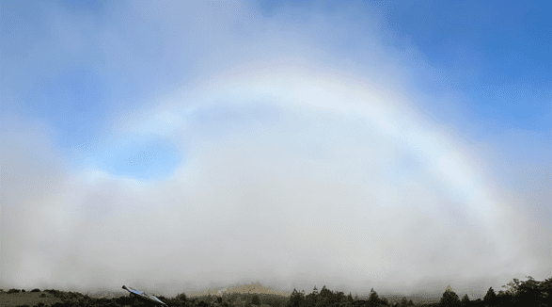

God’s Unstoppable Overflowing Love for the Faithful in the Church of Christ
Romans 8:31-39
Notes:
Eddie Williams ~ May 21, 2023 (AM)
~ January 28, 2024 (AM)

Slide 2
Romans 8:31-39 (KJV)
³¹ What shall we [THE CHURCH] then say to these things? If God [THE FATHER] be for us [THE CHURCH of CHRIST], who can be against us [THE CHURCH of CHRIST]?

Slide 3
Romans 8:31-39 (KJV)
³² He [THE FATHER] that spared not his own Son, but delivered him [CHRIST] up for us [THE CHURCH of CHRIST] all, how shall he [THE FATHER] not with him also freely give us [THE CHURCH of CHRIST] all things?

Slide 4
Romans 8:31-39 (KJV)
³³ Who shall lay any thing to the charge of God's elect [THE CHURCH of CHRIST]? It is God [CHRIST] that justifieth.
³⁴ Who is he that condemneth?

Slide 5
Romans 8:31-39 (KJV)
It is Christ that died, yea rather, that is risen again, who is even at the right hand of God [THE FATHER], who also maketh intercession for us [THE CHURCH of CHRIST].

Slide 6
Romans 8:31-39 (KJV)
³⁵ Who shall separate us from the love of Christ? shall tribulation, or distress, or persecution, or famine, or nakedness, or peril, or sword?

Slide 7
Romans 8:31-39 (KJV)
³⁶ As it is written, For thy sake we [THE CHURCH of CHRIST] are killed all the day long; we [THE CHURCH of CHRIST] are accounted as sheep for the slaughter.

Slide 8
Romans 8:31-39 (KJV)
³⁷ Nay, in all these things we [THE CHRURCH of CHRIST] are more than conquerors through him [CHRIST] that loved us.

Slide 9
Romans 8:31-39 (KJV)
³⁸ For I am persuaded, that neither death, nor life, nor angels, nor principalities, nor powers, nor things present, nor things to come,
³⁹ Nor height, nor depth, nor any other creature,

Slide 10
Romans 8:31-39 (KJV)
shall be able to separate us [THE CHURCH of CHRIST] from the love of God [FATHER, CHRIST, HOLY SPIRIT] which is in Christ Jesus [HIS CHURCH] our Lord.

Slide 11
UNSTOPABLE:
Nothing in All Creation Can Stop God from Loving Christ’s Church.
OVERFLOWING:
No Limits, Abounding

Slide 12
Three Points:
God Loves the Church so Much, He Sacrificed His Son for It
God Loves the Church of Christ so Much He Adopted Them into His Own Family
God’s Love for the Church of Christ is Unstoppable and Everlasting

Slide 13
Point #1: God Loves the Church so Much, He Sacrificed His Son for It
Romans 8:32 (KJV)
I John 4:9-10 (KJV)
Ephesians 5:25 (NLT)

Slide 14
Romans 8:32 (KJV)
He that spared not his own Son, but delivered him up for us all, how shall he not with him also freely give us all things?

Slide 15
I John 4:9-10 (KJV)
⁹ In this was manifested the love of God toward us, because that God sent his only begotten Son into the world, that we might live through him.

Slide 16
I John 4:9-10 (KJV)
¹⁰ Herein is love, not that we loved God, but that he loved us, and sent his Son to be the propitiation for our sins.

Slide 17
Ephesians 5:25 (NLT)
For husbands, this means love your wives, just as Christ loved the church. He gave up his life for her

Slide 18
Point #2: God Loves the Church of Christ so Much He Adopted Them into His Own Family
I John 3:1-3 (KJV)
Romans 8:14 (NLT)
II Corinthians 6:18 (NLT)

Slide 19
I John 3:1-3 (KJV)
¹ Behold, what manner of love the Father hath bestowed upon us, that we should be called the sons of God: therefore the world knoweth us not, because it knew him not.
² Beloved, now are we the sons of God,

Slide 20
I John 3:1-3 (KJV)
and it doth not yet appear what we shall be: but we know that, when he shall appear, we shall be like him; for we shall see him as he is.
³ And every man that hath this hope in him purifieth himself, even as he is pure.

Slide 21
Romans 8:14 (NLT)
For all who are led by the Spirit of God are children of God.

Slide 22
II Corinthians 6:18 (NLT)
And I will be your Father, and you will be my sons and daughters, says the Lord Almighty."

Slide 23
Point #3: God’s Love for the Church of Christ is Unstoppable and Everlasting
Romans 8:38-39 (KJV)
John 10:28 (KJV)
Romans 4:21 (KJV)

Slide 24
Romans 8:38-39 (KJV)
³⁸ For I am persuaded, that neither death, nor life, nor angels, nor principalities, nor powers, nor things present, nor things to come,

Slide 25
Romans 8:38-39 (KJV)
³⁹ Nor height, nor depth, nor any other creature, shall be able to separate us from the love of God, which is in Christ Jesus our Lord.

Slide 26
John 10:28 (KJV)
And I give unto them eternal life; and they shall never perish, neither shall any man pluck them out of my hand.

Slide 27
Romans 4:21 (KJV)
And being fully persuaded that, what he had promised, he was able also to perform.

Slide 28

…that Christ died for our sins according to the scriptures;
And that he was buried, and that he rose again the third day according to the scriptures:

Slide 29
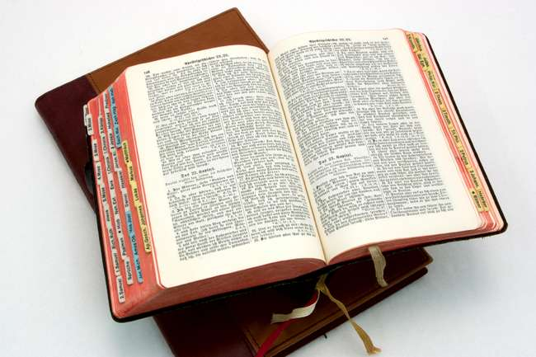
Hear: Romans 10:17
So then faith cometh by hearing, and hearing by the word of God.

Slide 30
Believe: Hebrews 11:6
But without faith it is impossible to please him: for he that cometh to God must believe that he is, and that he is a rewarder of them that diligently seek him.

Slide 31
Repent: Luke 13:3
I tell you, Nay: but, except ye repent, ye shall all likewise perish.

Slide 32
Confess: Matthew 10:32-33
32 Whosoever therefore shall confess me before men, him will I confess also before my Father which is in heaven.
33 But whosoever shall deny me before men, him will I also deny before my Father which is in heaven.

Slide 33
Baptize: Acts 22:16
And now why tarriest thou? arise, and be baptized, and wash away thy sins, calling on the name of the Lord.

